Slide 1
ABS Life Coach
CMPT475/477 - CS/IS/IT
Capping Fall 2017
Patrick Zambri, Bradford Harris, Marisa Proscia, Christopher Siena, Jacob Levinson
Notes:
BRAD

Slide 2
Life Coach
Life Coaching is a profession that is designed to help clients live happy, healthy, and fulfilling lives. Different from counselors or mentors, life coaches address specific needs, wants, and problems of their client. They help their clients overcome life obstacles, and help design a plan for their clients so they can live their best lives.
In doing this, life coaches help clients “push the pause button” and take some time to reflect and relax. They promote personal and professional growth for clients and their families.
Notes:
BRAD

Slide 3
Our Goal
Our main goal is to deliver a product to our customer that allows life coaches to interact with their clients and efficiently provide advice and guidance. In doing so we will be a key factor in allowing the life coaches to do their jobs and successfully ensure that their clients are living the lives they want to live.
Notes:
BRAD

Slide 4
How It’s Made
We have designed an intuitive mobile-friendly website that allows the life coaches to efficiently record notes and interactions with their clients and their families. Our system is designed with the intentions of our client in mind:
Help clients reach their highest potential personally, socially, and professionally
Help clients set and realize their goals, and make sure that they stay on task
Set their clients on the correct path to reach those goals
Help clients balance the stresses of everyday life
Interact one-on-one with clients and clients’ families
Notes:
BRAD

Slide 5
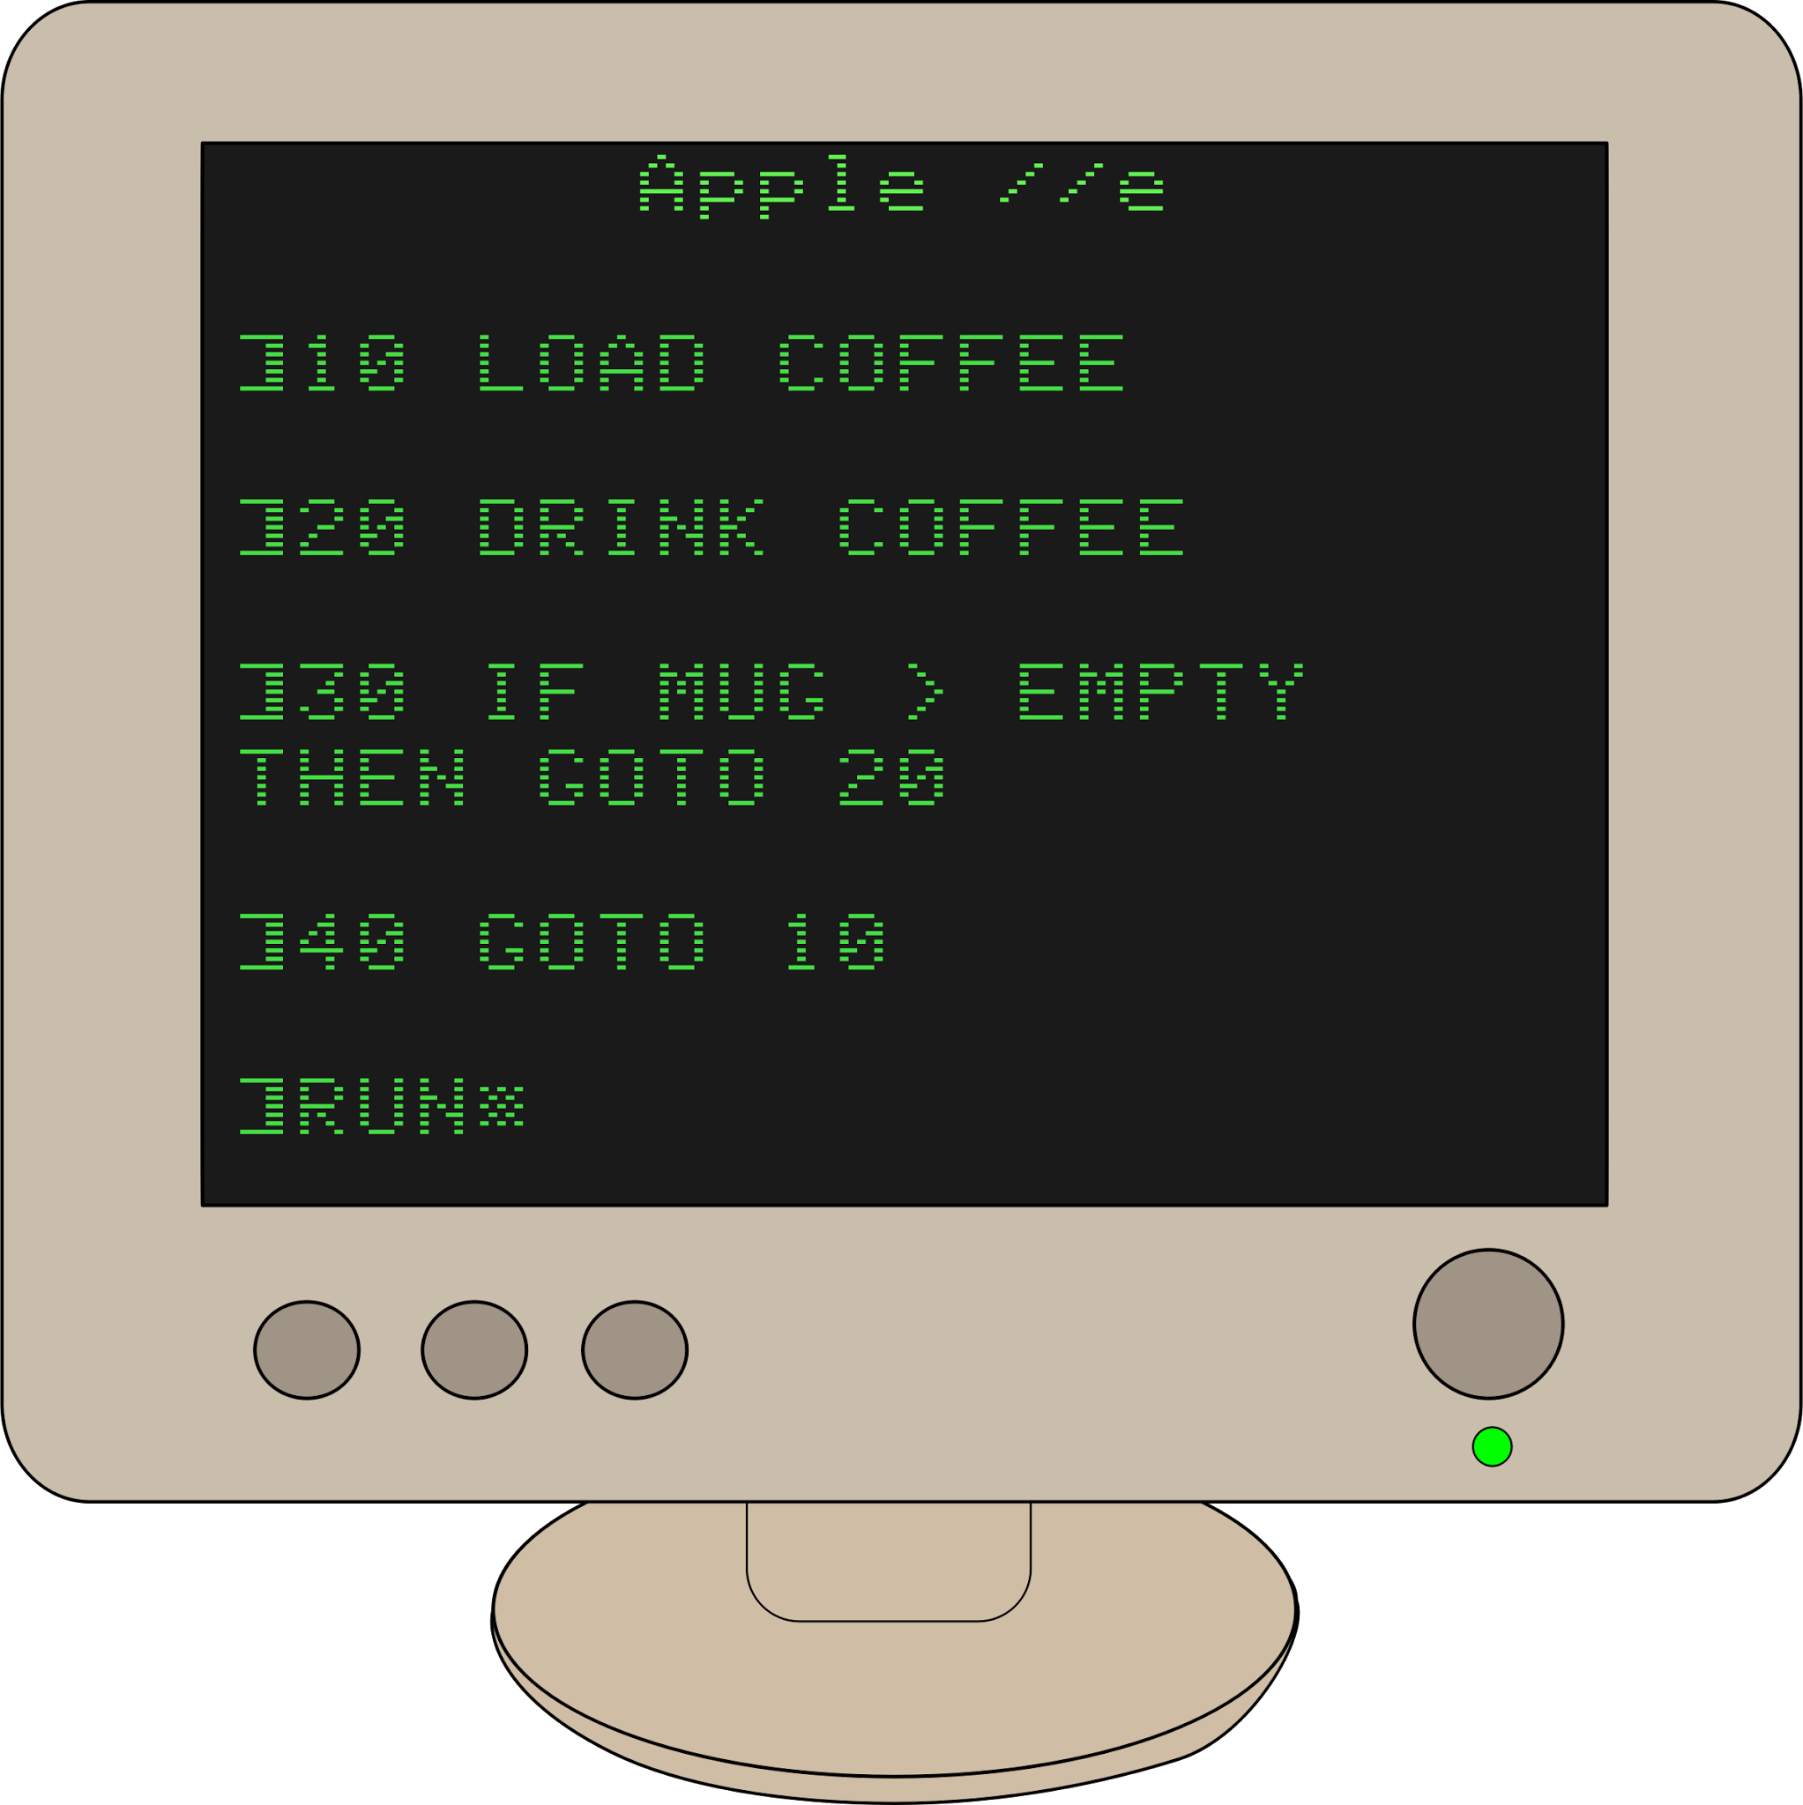



Project Plan
Research & Pre-Planning
Implementation & Development
Documentation & Fine Tuning
User Requirements & IT/Technical Requirements
Scope of the Project
Mock site for client
Weekly Meetings with Client & Development Group
Daily Communication with Development Group
Compile Documentation for Client
Prepare system for Delivery
Notes:
MARISA

Slide 6
Our user requirements (Clients)
System in which a Life Coach can keep track of Client’s lives, families and life events
Client Scheduling
Notes
Life Events
Family Tree(including family info)
Reminders
Convenient View of Client Profile to show Client info, family tree, notes and life events
Notes:
JACOB

Slide 7
Our user requirements (Hierarchy)
Hierarchy tree for different employees and ability to license this out:
Coaches can:
View/edit all clients, assign clients to coaches, and set appointments
Supervisors are coaches, can
Add/drop coaches
Admins are:
In charge of their own company
Super Admin can:
Make changes and update the system and license the site out
Notes:
JACOB

Slide 8
Our user requirements
Security is high priority, HTML5 & CSS3 for mobile friendly site
10 million users
1,000 concurrent
LAPP Server
Run HTTPS
Notes:
JACOB

Slide 9
Backend
LAPP setup
Google server
Services
Ubuntu 16.04
Apache2
PostgreSQL
PHP7
Notes:
PAT
As the IT lead for our team, my focus was on the back end of the project.
For our project, we are running a LAPP setup. This stands for Linux, Apache, PostgreSQL, and PHP.
Ubuntu linux 16.04 is the operating system we are running on our live, production google server.
Apache2 is the web server we have our website running on (is this actually an accurate statement).
Postgresql is our database which store all of our client, coach and other information, and PHP7 is the server side web scripting language we used for web development.
-We runnin a lapp setup on a google server
-Ubuntu 16.04, Apache2 (webserver), PHP7 (coding language?), and PostgreSQL (which is our database)
-For security: PHP Mcrypt (idk what that does), UFW Firewall (commonly used firewall for ubuntu) ports deny by default except for the specific ports we need access to, HTTPS Certification (and auto redirect so you can't use http) and server backups being made (in future it will follow a set schedule)
-Load balancing/Testing
-Unable to do this with current configuration.

Slide 10
Backend Security and Load Management
SSH Key for server login
UFW Firewall
Deny by default
HTTPS Certification
Auto direct
Database backups
Load balancing/Testing
Unable to do this with current configuration.
Notes:
PAT
The backend also includes much of our security considerations. On the ubuntu server we are using UFW firewall for port blocking, which is a common firewall selection for ubuntu users. We have, by default, deny all rules set up for incoming and outgoing traffic except on the ports we need. On our web end, we have HTTPS certification and auto redirect is set up so that no one can end up on the http version of the site. As for the database, we have backups of the database saved, and for load balancing, with this current configuration, we only have one server, and therefore cannot load balance. In our documentation we have information on how load balancing would be enabled using HAProxy.
Up next, I’ll hand it off to (whoever is next) who will cover front end development.
For security: PHP Mcrypt (idk what that does), UFW Firewall (commonly used firewall for ubuntu) ports deny by default except for the specific ports we need access to, HTTPS Certification (and auto redirect so you can't use http) and server backups being made (in future it will follow a set schedule)
Load balancing/Testing
Unable to do this with current configuration.

Slide 11
Front End Development
PHP
7,546 lines of code
Over 300 hours
CSS
Bootstrap
Custom CSS
198 lines
Javascript - JQuery
Family Tree
dTree
D3
Iodash
Calendar
FullCalendar
Notes:
Chris

Slide 12
Database Development
13 Tables
5 views
Referential integrity
Notes:
Chris

Slide 13
Live Demo
Notes:
Chris
Make sure to hit on best points of the site
Address features that were difficult / extra and our process to get there
Family tree, family tree, family tree
Live on the web it’s ABSLIFECOACH!!!!!!

